Slide 1

Dashboards Reporting System
User Manual
The Dashboard System monitors every single part of the operation and provides the management with many sophisticated reports
which include critical data and statistics as well as pointing out specific bottlenecks in operation, productivity and customer service.

Slide 2
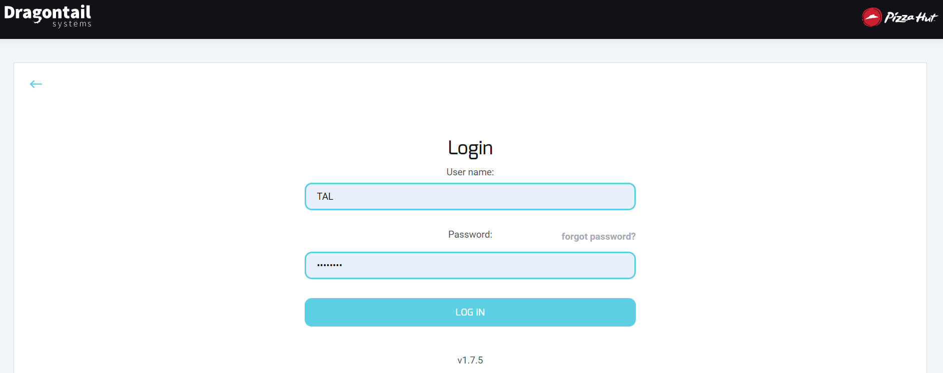
Dashboards - Logging in
A new user will receive a link to access the dashboard as well as their username and password from Dragontail Support.
On the first time the user logs into the Dashboards they will be prompted to change the password.
When the user changes their password, the system will require specific password, should contain 3 of:
Capital letters, numbers, letters and signs (min 7 characters).
Example: Jhony12
The system will prompt the user to change the password every 3 months
If a new username is required please contact DT Support

Slide 3
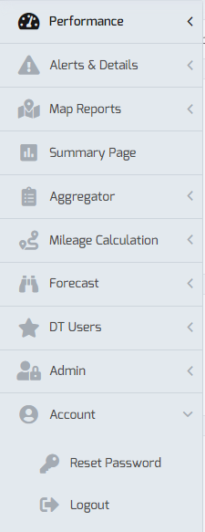
Dashboards - Logging in
Option to RESET PASSWORD
Under the Reports Menu

Slide 4
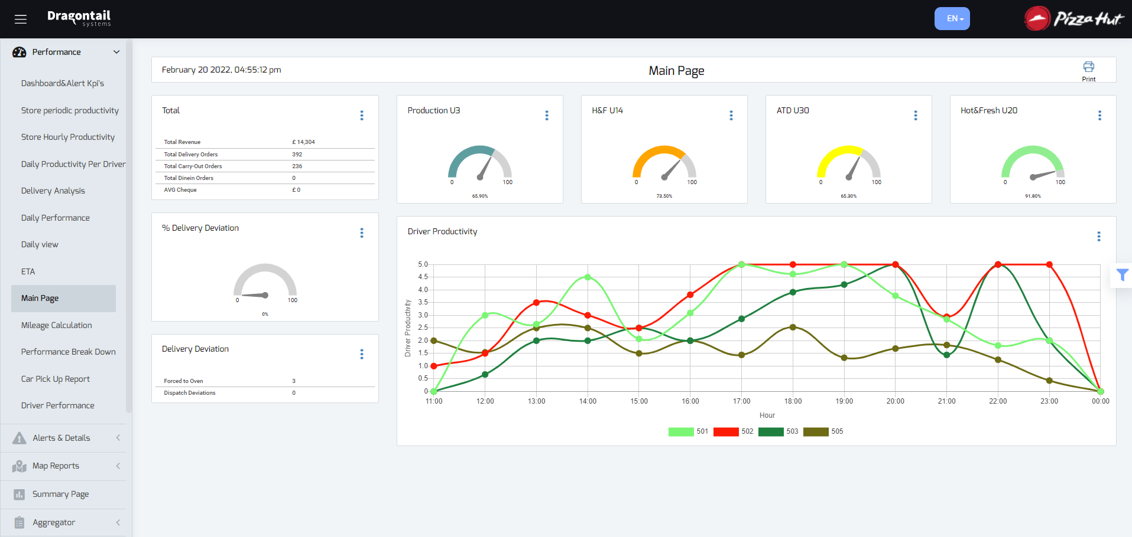
Main Page Report
(Upon opening the Dashboards)
Reports Menu
Production time
U3 min
Hot % Fresh
U14 min
At the door time
U30 min
Hot % Fresh
U20 min
Filter Panel
Store/s
Deviations
from system
recommendations
Driver’s productivity (amount of deliveries per hour per driver by store)

Slide 5
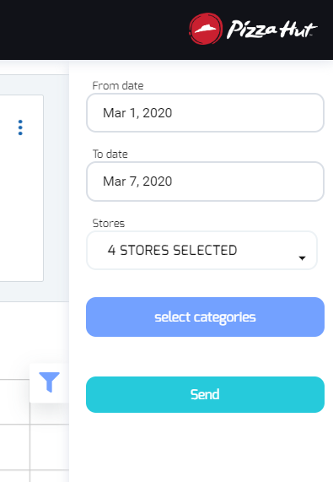
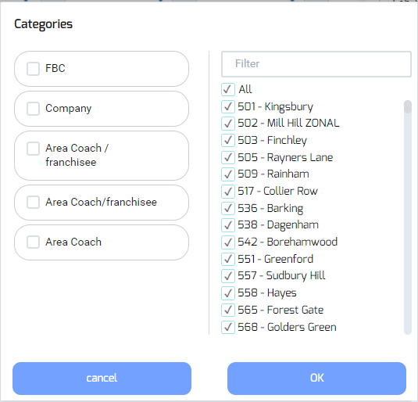
Filter Panel
On the right-hand side of the screen, click the filter icon to open the filter panel.
Then choose the relevant dates and store/s you would like to review.
Select Date
Upon opening the Dashboard,
the default date range is for
the day before
Select Date to show data up to
Select the store number/s
Click the checkbox to select or unselect
After choosing the correct date
and store/s, Click “Send”
Option filter by category
(company, area coach etc.)

Slide 6
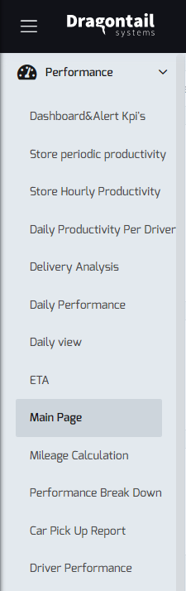
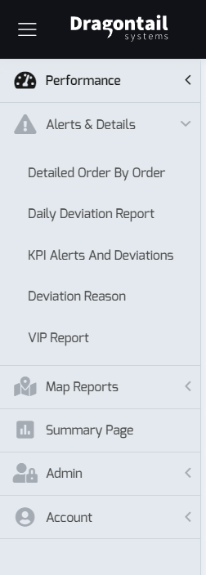
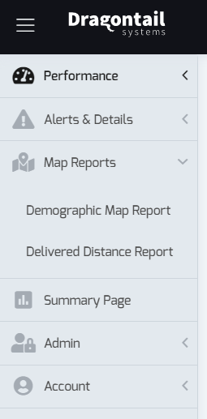
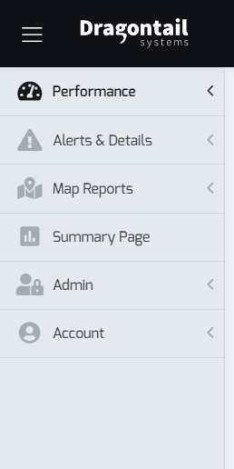
Reports Menu
(located on the left-hand side of the page)
The “Performance” tab:
The “Alerts & Details” tab:
The “Map reports”:
Summary Page:
Click to expand/un expand the menu

Slide 7
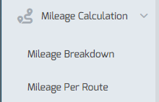
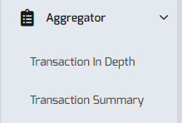
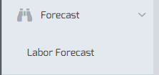
Reports Menu cont
(located on the left-hand side of the page)
The “Aggregator” tab:
The “Mileage Calculation” tab:
The “Forecast” tab:

Slide 8
“Performance” tab Reports

Slide 9
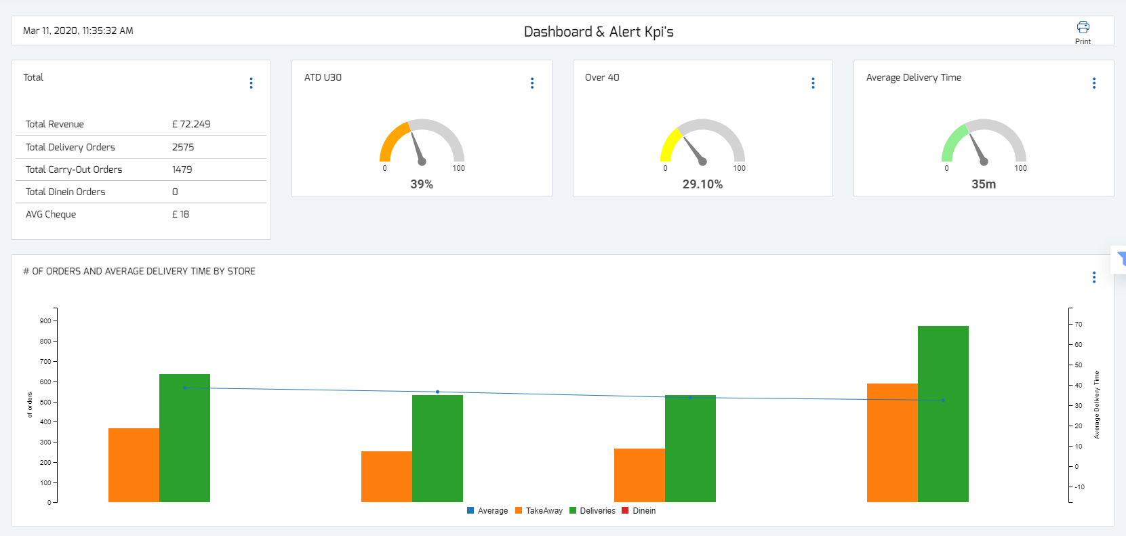
The Dashboard & Alert KPI’s Report
The top section:
Key delivery times statistics
Amount of orders separated to sale types (Carryout, Delivery, Dine-in)

Slide 10
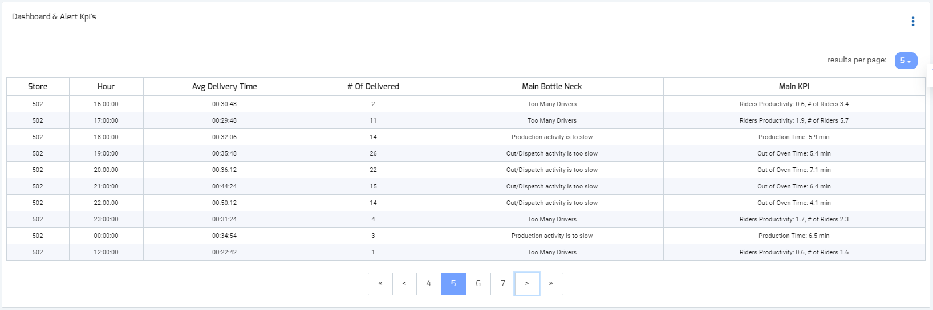
The Dashboard & Alert KPI’s Report
The bottom section (main bottlenecks):
Clicking any column title will sort the table according to that column, a second click will sort the other way round (ascending, descending)
Store/s
Main operational bottle neck during that hour,
this is the bottom line for the manager to act upon
This is the data the “main bottle neck” is based on
(Examples on the next slide)

Slide 11
Main bottlenecks and KPI’s
Full list of bottleneck types:
KPI examples:
Main Bottle Neck | Main KPI | Explanation
Production activity is too slow | Production time: 6.5 mins | Production time: time since order was displayed on the screen until bumped – the time was above the standard
Cut/Dispatch activity is too slow | Out of oven time: 7 mins | Out of oven time: time since order came out of the oven until being dispatched – the time was above the standard (should range between 2 - 5 min)
Insert to oven not according to Algo | Problematic orders “…” | When orders that are recommended by the system to “hold” are inserted to the oven
Too many drivers | Drivers productivity: 1.5 | The driver’s productivity is lower than it should be by standard (should range between 2 – 3 per hour)
More drivers needed | Hold time: 8 mins, # of drivers: 3 | The avg. time orders were on “hold” due to no available drivers
More cooks are needed | Time to Make table: 14 mins | The avg. time orders were pending in the background before being displayed on the KDS – the time was above the standard (up to 7 min)
Drivers productivity is too low | Drivers productivity: 1.5, # of drivers: 4 | The driver’s productivity is lower than it should be by standard (should range between 2 – 3 per hour)

Slide 12
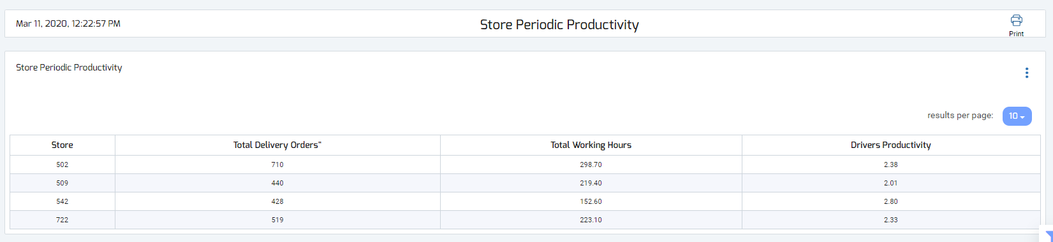
Store Periodic Productivity Report
Summarizes total deliveries, driver’s hours and driver’s productivity for the selected period,
The report indicates whether the driver’s productivity was acceptable for the chosen period.
Store/s
This is calculated by: total deliveries divided by total driver’s hours
The standard productivity should range between 2 - 3 per hour
The total amount of hours all the drivers worked
(according to assignments to vehicles on Dispatch)

Slide 13
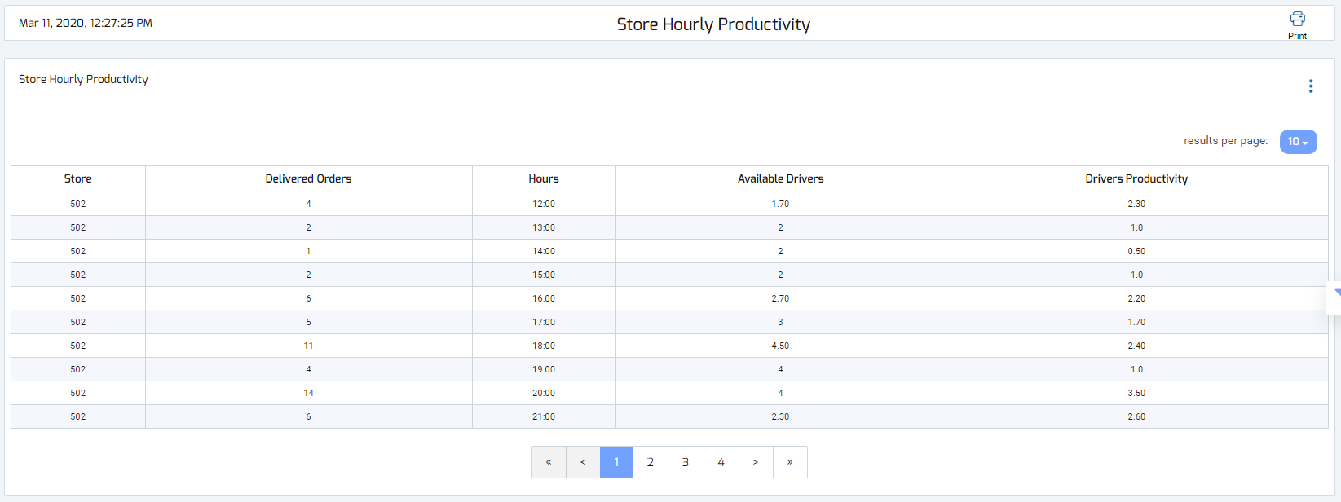
Store Hourly Productivity Report
Summarizes for each hour of the day: total deliveries, total amount of driver’s and driver’s productivity.
The report indicates whether the driver’s productivity was acceptable during each hour of the day.
Store/s
This is calculated by the total deliveries divided by the total amount of driver’s available per hour
The standard productivity should range between 2 - 3 per hour

Slide 14
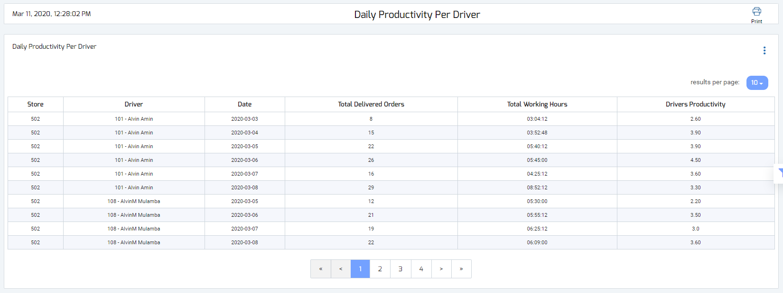
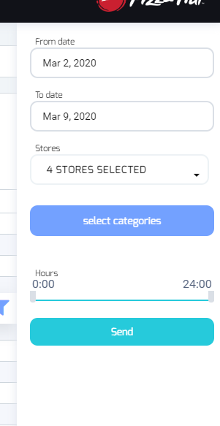
Daily Productivity Per Driver Report
Displays each driver (name & employee ID) and his/her productivity for the selected time
Option to
filter hours
Store/s
Driver name
The driver’s personal productivity is calculated by taking the total delivered orders,
divided by the total working hours of that driver
The standard productivity should range between 2 - 3 per hour

Slide 15
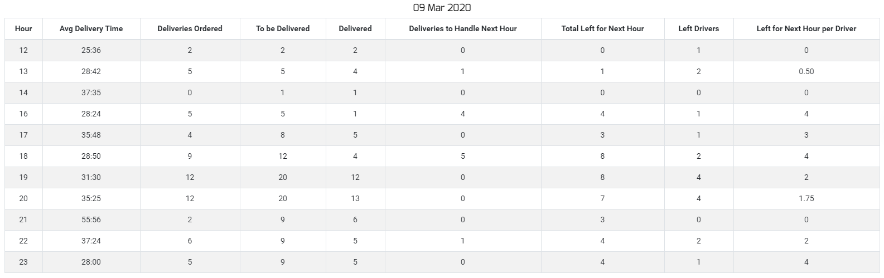
Delivery Analysis Report
Detailed analysis of deliveries and drivers broken down to each hour of the day,
Points out specific problematic hours that caused a backlog for the upcoming shift
Total deliveries
ordered during
that hour
Remaining orders
that were not delivered
(including previous hours)
Amount of orders left to deliver
for each driver in the next hour
(in addition to upcoming orders
that may arrive)
Orders delivered
during that hour
Total deliveries to be
delivered including
previous hours
Remaining orders
that were not delivered
(from that hour)
Amount of drivers
available for the next
hour to take deliveries

Slide 16
Delivery Analysis Report
On many occasions a full shift can be impacted by not having enough drivers during specific hour/s.
If during a certain hour not all deliveries were provided, they are left over for the next hour and so on.
When this happens it is usually difficult for the store to get back on track (unless additional drivers are added quickly),
as new orders keep coming in, Creating a backlog of orders.
Example: Between 17:00-18:00
15 deliveries, 4 drivers
Each driver took 2.5 deliveries = 10
Deliveries left for next hour = 5
Perhaps adding a driver one hour earlier in the shift could have saved the whole evening….?
This report is a useful tool to spot the exact hours this problem occurred and how it effected the rest of the shift

Slide 17
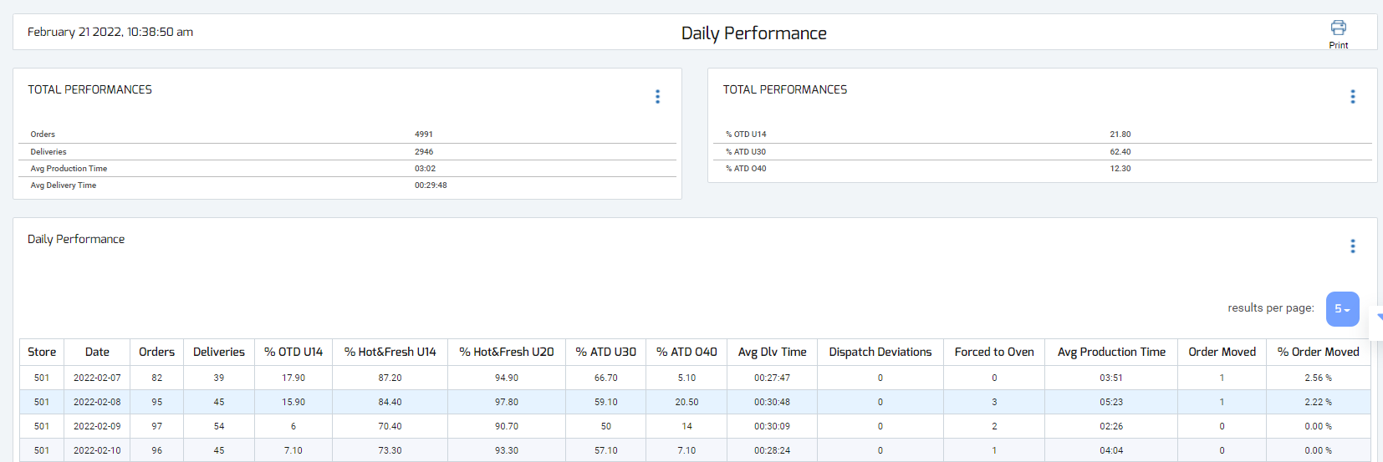
Daily Performance Report
Total amount of orders overall for the chosen time frame,
deliveries specifically,
and performance statistics in preparation & delivery
% of orders that were Out The Door in under 14 min
% of orders that arrived in under 30 min
% of orders that arrived in over 40 min
Store/s
Deviations from the system’s dispatching
and Make recommendations

Slide 18
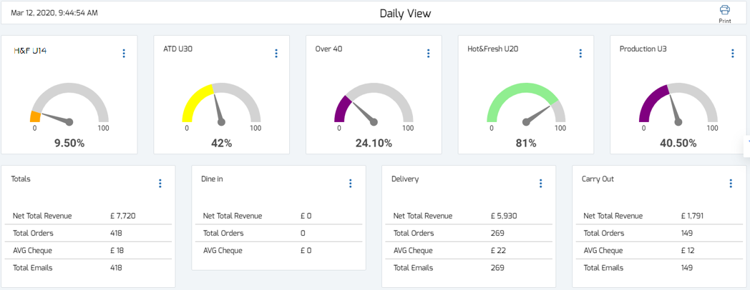
The Daily View Report
Store performance in depth and critical data, separated into each hour of the day as well as the driver’s productivity per hour
Orders that were
Hot&Fresh
in under 14 minutes
Orders with
production time
under 3 min
Key Delivery times statistics
Product quality meter
Total Revenue, total orders and avg. payment per cheque, separated into sale types (Dine in, Delivery, Carry-out)
Total Emails = Total tracker emails sent to customers (delivery & Carry-out only)
Notes:
Delivery times are calculated using the time the order was taken and the time the order was delivered.
Product Quality meter – the time passed from driver’s Out of the door time till delivery time

Slide 19

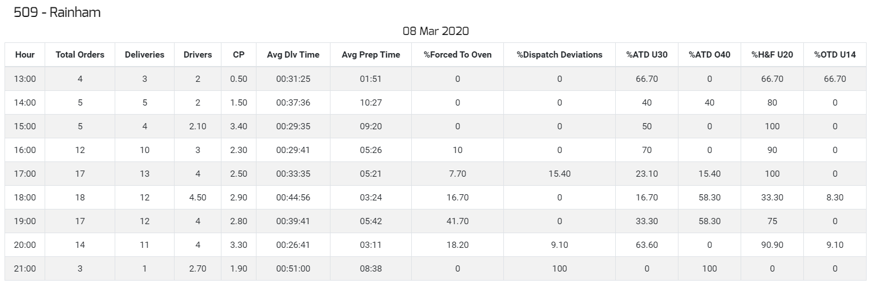
The Daily View Report
The bottom section:
Average delivery time
Average production
Time at Make Table
Hot&Fresh
Under 20 min
Out the Door
In under 14 min
Driver’s productivity during that hour
This is calculated according to the amount of deliveries divided by the amount of drivers for each hour
The standard productivity should range between 2 – 3 per hour

Slide 20
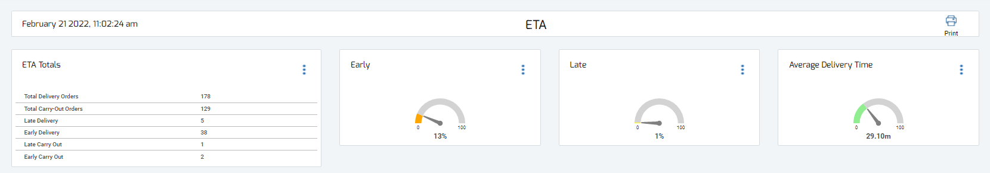
Estimated Time Of Arrival
Meeting ETA objectives
Early Delivery %
Late Delivery %
Average Delivery time
in minutes
ETA Totals breakdown
Notes:
Delivery times are calculated using the time the order was taken and the time the order was delivered.
Product Quality meter – the time passed from driver’s Out of the door time till delivery time

Slide 21
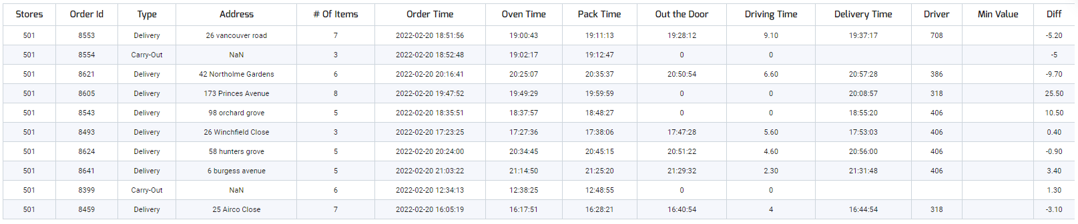
Estimated Time Of Arrival
The bottom section:
Order time
Difference between
ETA and actual time
Actual delivery time
Table presenting order details, receiving order until delivery/Carry out time, exceeding from promise time

Slide 22
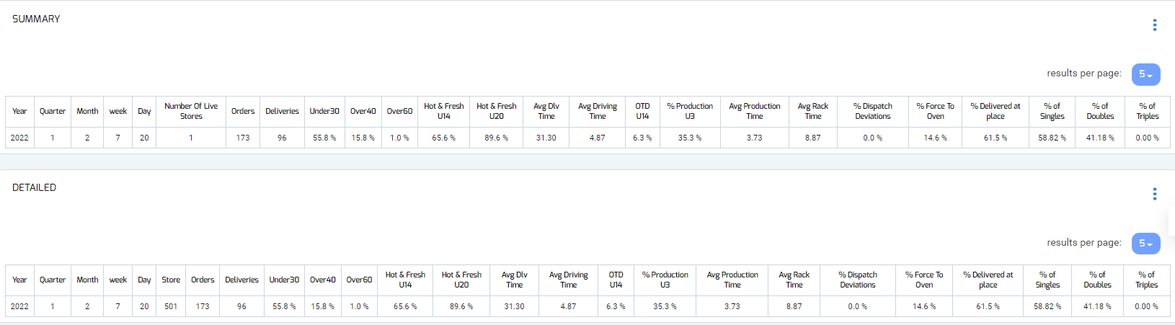
Performance Break Down
Summary and Detailed Tables:
Daily based KPI report
Percentage of single, double, and triple deliveries
Percentage based performance breakdown presenting data per day and per store with the option to filter a number of stores

Slide 23
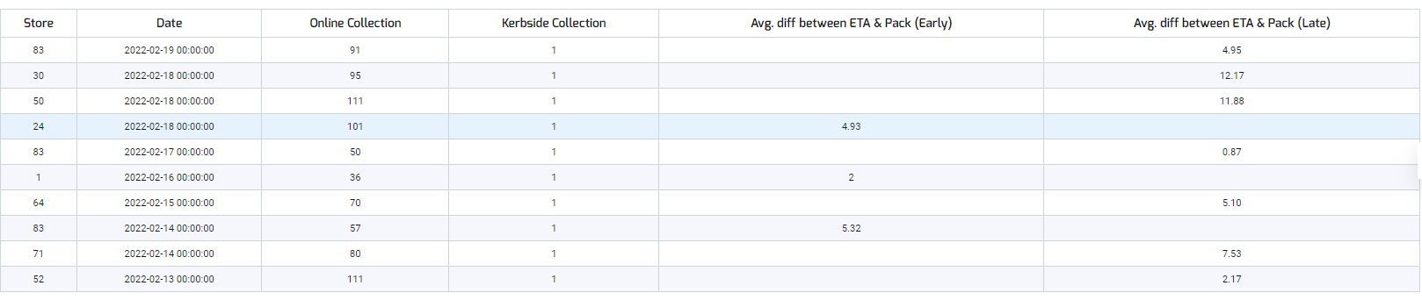
Car Pick Up Report
Earlier than ETA
Later than ETA
A table presenting data for car pick up (drive-through) per day

Slide 24
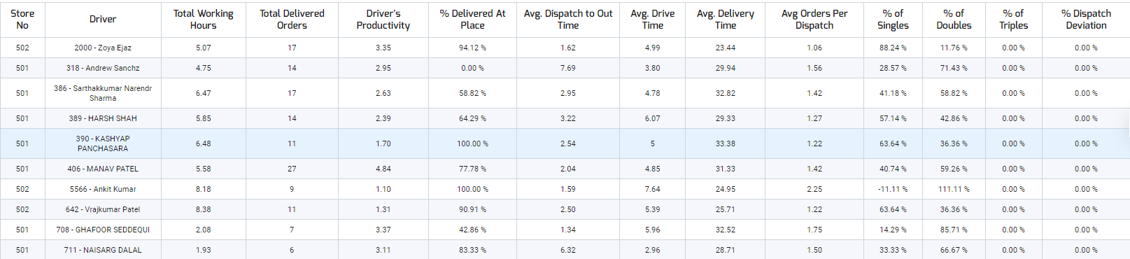
Driver Performance
Percentage of single, double, and triple deliveries
Productivity Break down
Averages pointing drivers' performance
Driver performance breakdown per each driver

Slide 25
“Alerts & Details” tab Reports

Slide 26
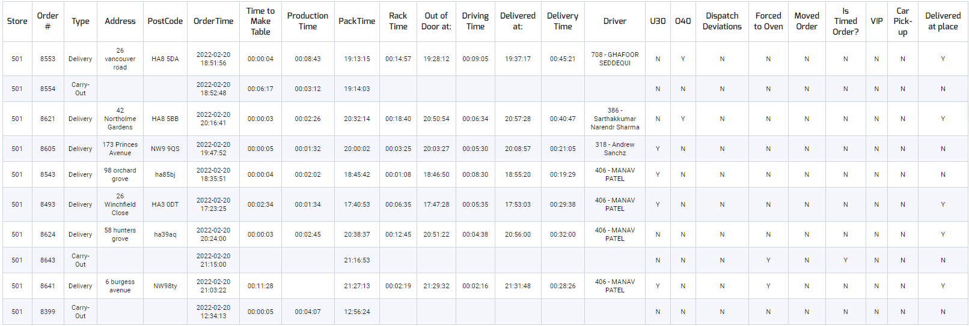
Detailed Order by Order Report
This report displays every single order with all the details in depth,
and is very helpful when certain details are required for an inquiry or investigation
Y - yes
N - no
Store/s
Fields:
Orders (order numbers)
Type (carry out/delivery/dine in)
QTY (amount of items)
Address
Order Time (the time the order was taken)
Pack Time (time order was bumped from Pack)
Time to Make Table (the time passed since
order was taken until order appeared on Make)
Production time (from time the order appeared on Make until bumped)
Out the door at (time the driver left the store)
Driving time (time since driver left the store until arrival to delivery)
Delivered At (time the order was delivered at)
Delivery time (time passed since order was taken until delivered to customer)
Driver (employee number & name of the driver)
U30 (under 30 min ATD time)
O40 (over 40 min ATD time)

Slide 27
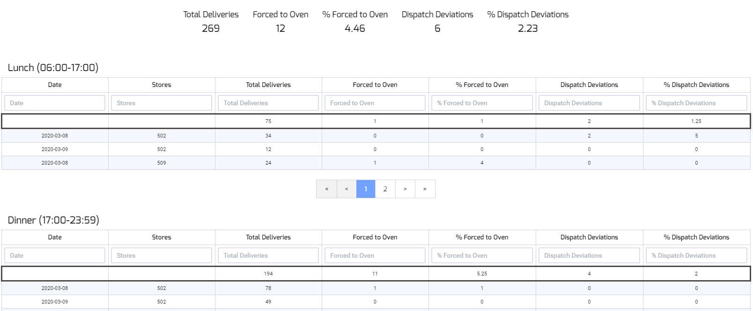
Daily Deviation Report
Summarizes the deviations made from the system’s dispatching and kitchen recommendations
Summary Full Day
Store/s
Store/s
Total
Orders that were forced to the oven while system recommendation was to “hold”
Orders that were dispatched not per the system’s recommendation

Slide 28
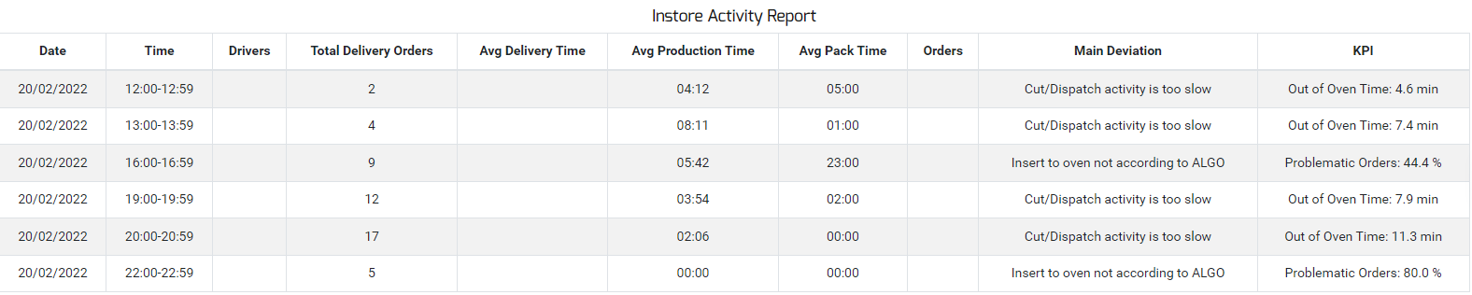
KPI Alerts and Deviations
Provides detailed information on all bottlenecks and alerts in-store operation
Main bottleneck
Data it is based on

Slide 29
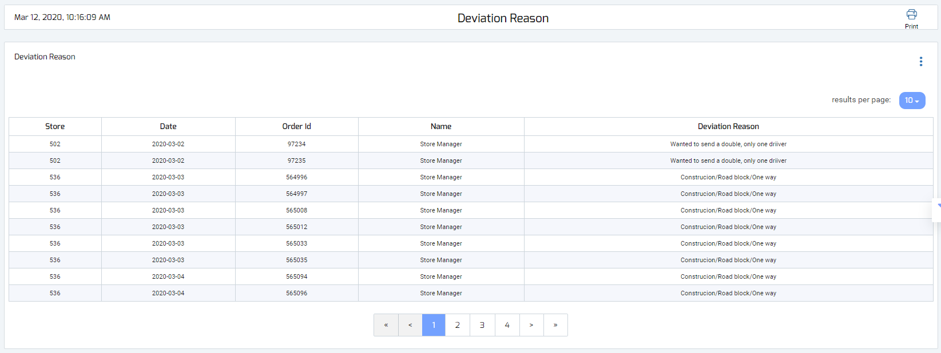
Deviation Reason
Displays every single dispatch deviation details and the ‘reason’ selected by manager
Store/s

Slide 30
“Map Reports” tab

Slide 31
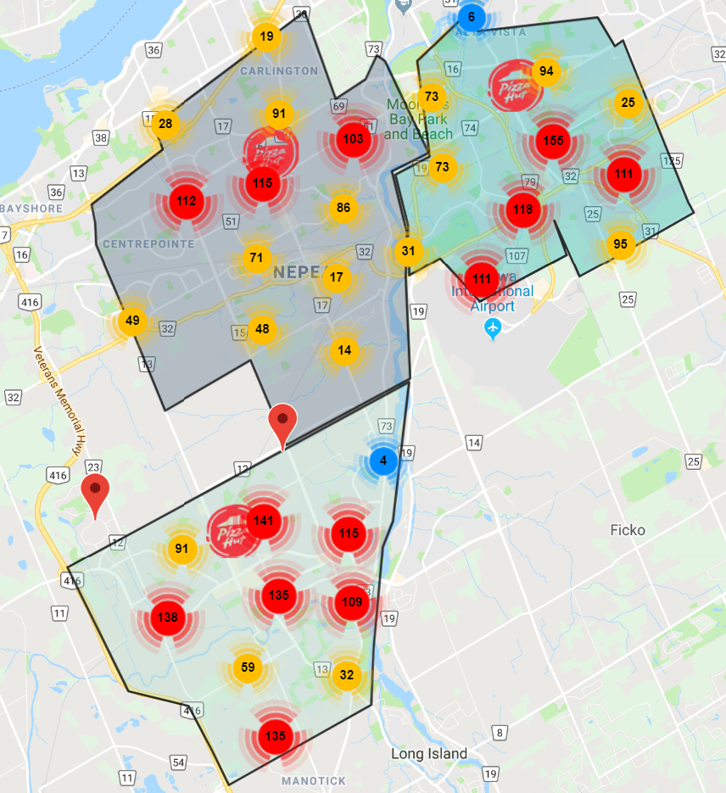
The Demographic Map Report
The Heat Map displays the orders on an electronic map and is a great proprietary tool that helps executives analyze and manage their coverage areas
The report specifically points out soft spots, areas with a great growth potential and risky zones (areas with late delivery times), as well as a great tool for re-organizing delivery areas.

Slide 32
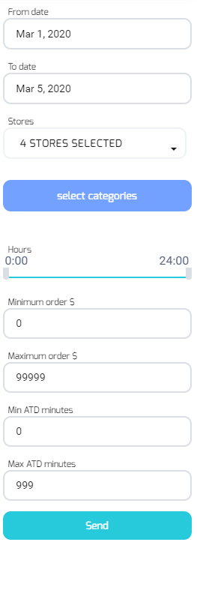
The Demographic Map Report
Choose the dates
There’s an option to review 1 or more days
Choose the relevant store, there is an option
to view one or multiple stores
Choose the hours you would like to look at
Option to filter the deliveries according to their
payment amount
Option to filter the deliveries according to
their (ATD) at the door time
Click “Send” to see the updated data
Notes:
Filtering the deliveries according to the payment amount - this is a great marketing tool which helps to easily spot the soft and strong areas in the trade zone in terms of payment.
Filtering the deliveries according to their at the door time - this is useful for pulling out problematic areas, as well as enabling the management to identify where changes in trade zones may be needed.

Slide 33
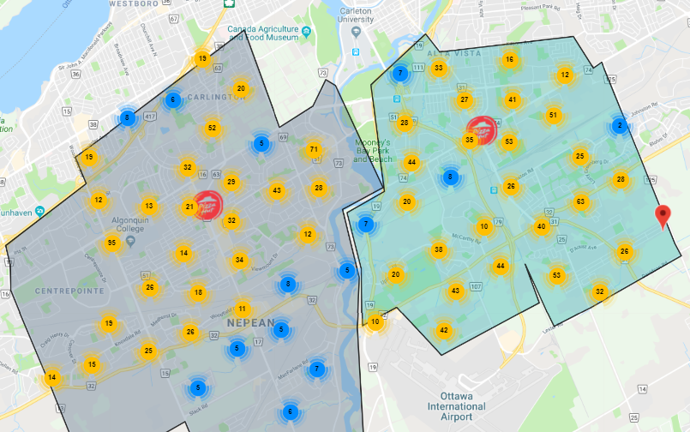
The Demographic Map Report
The map displays the selected store/s and all their deliveries in their location on the map
Deliveries that are in the same area
are grouped together into a bubble,
the number of deliveries grouped is
written on the bubble

Slide 34
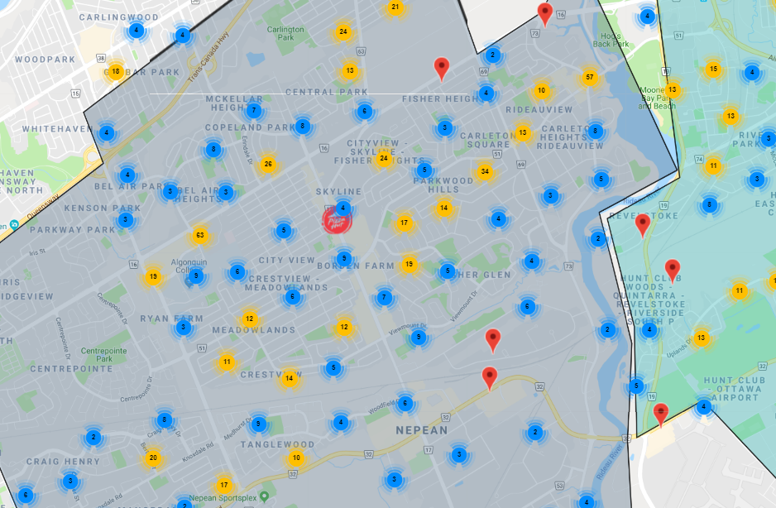
The Demographic Map Report
The manager can zoom in and see the areas and deliveries more closely and specifically
By zooming in fully, the map displays each and every delivery in its exact location on the map

Slide 35
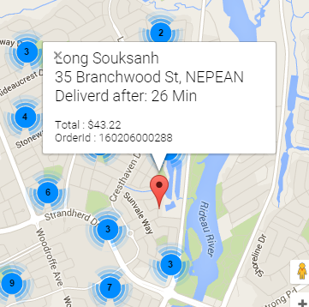
The Demographic Map Report
Hovering over the location icon will show a pop up:
Customer name
Address
Delivery time
Payment amount
Order number

Slide 36
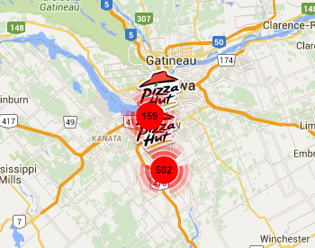
The Demographic Map Report
By zooming out fully, the manager can quickly see the total amount of deliveries in each store for the selected dates

Slide 37
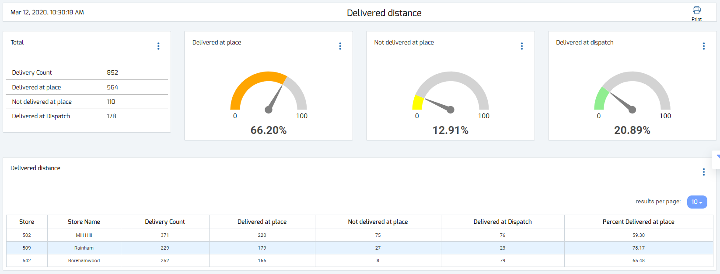
The Delivered Distance Report
This report informs regarding the distance from location in which the drivers clicked the “delivered” button on the App and indicates for management how accurate the drivers “delivered” reporting is.
% of orders delivered within the defined distance from delivery location
% of orders that were not delivered within the defined distance from location
% of orders delivered
manually from the
Dispatch in the store
Store/s

Slide 38
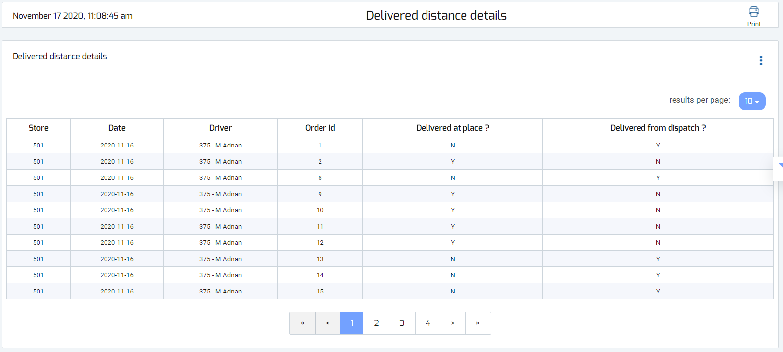
The Delivered Distance Details Report
This report displays a break down per order and whether the driver
marked the order as ‘delivered’ in the customer’s location or not.
Y - Yes
N - No
Store/s
Driver names

Slide 39
“Summary Page” tab

Slide 40
The Summary Report
All the important information gathered into one report!
The top section:
Key delivery times statistics
Amount of orders separated to sale types (Carryout, Delivery, Dine-in)

Slide 41
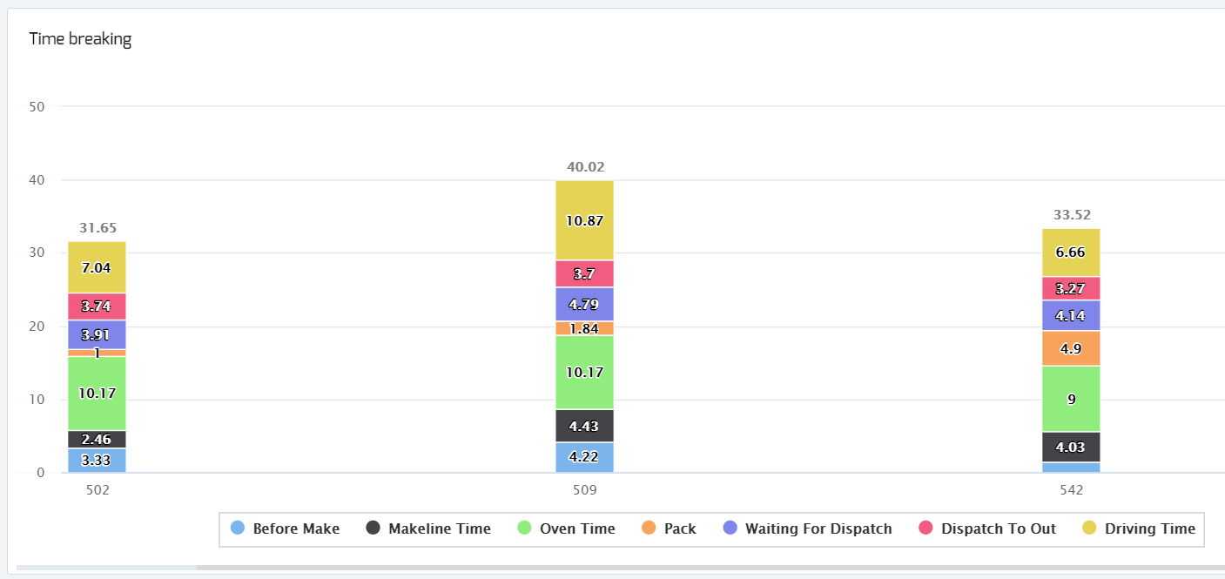
The Summary Report
The “Time Breaking” section:
Displays all the operational stages broken down by time and allows to analyze the avg. time taken for each stage.
This allows to pinpoint operational bottlenecks very quickly, as well as compare between multiple locations.
The time is broken down to:
Before Make - from time order was taken until it reached the Kitchen Screen for preparation
Makeline Time - from time order appeared on the Kitchen Screen until it was bumped
Oven Time - from time order was bumped from the Kitchen until 7.75 min oven time has passed
Pack Time - from the moment 7.75 min passed until the order was bumped from Pack screen
Waiting for Dispatch - from time order was bumped at the Pack Screen until it was dispatched
Dispatch to out - from time order was dispatched to a driver until the time the driver left the store
Driving Time - from time the system recognized the driver was out of the door until the driver clicked "delivered" on the DT App
Store/s
Store/s
Store/s

Slide 42
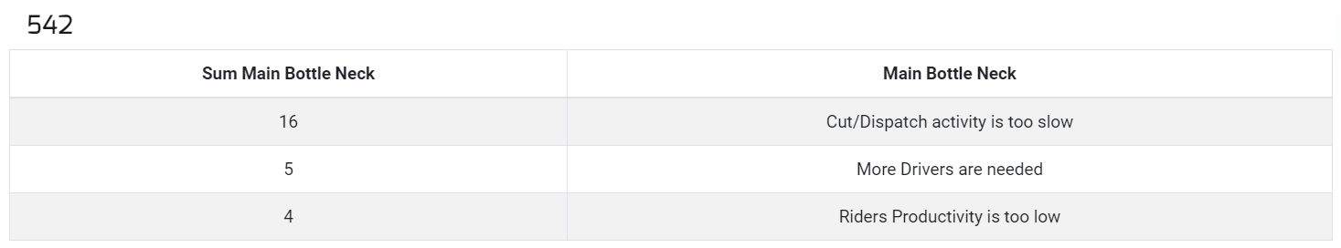
The Summary Report
Main Bottlenecks Section:
This section lists for each store the top 3 bottlenecks throughout the selected period.
"Sum main bottle neck" is the amount of times the system alerted this bottleneck during the selected time.

Slide 43
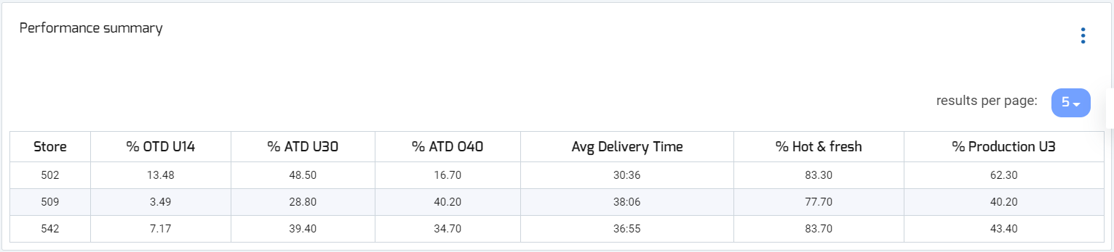
The Summary Report
Performance Summary Section :
Summarizes for each store: performance statistics broken down to out the door times, delivery times, Hot & fresh percentage and under 3 min production time percentage.
Store/s

Slide 44
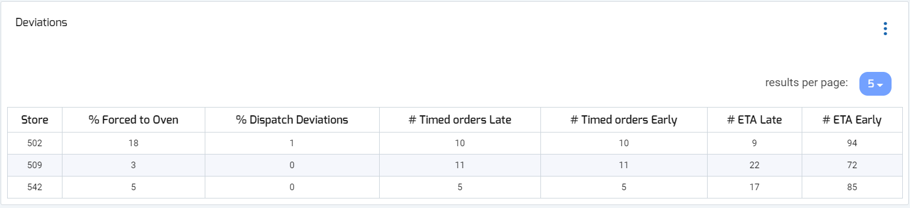
The Summary Report
Deviations Section includes:
- The staff deviations from the system recommendations both in the kitchen and on the dispatch
- Timed orders latency: how many timed orders arrived to the customers earlier or later than the due time
- Promise time accuracy: how many orders arrived to customers earlier or later than the promise time provided
Store/s

Slide 45
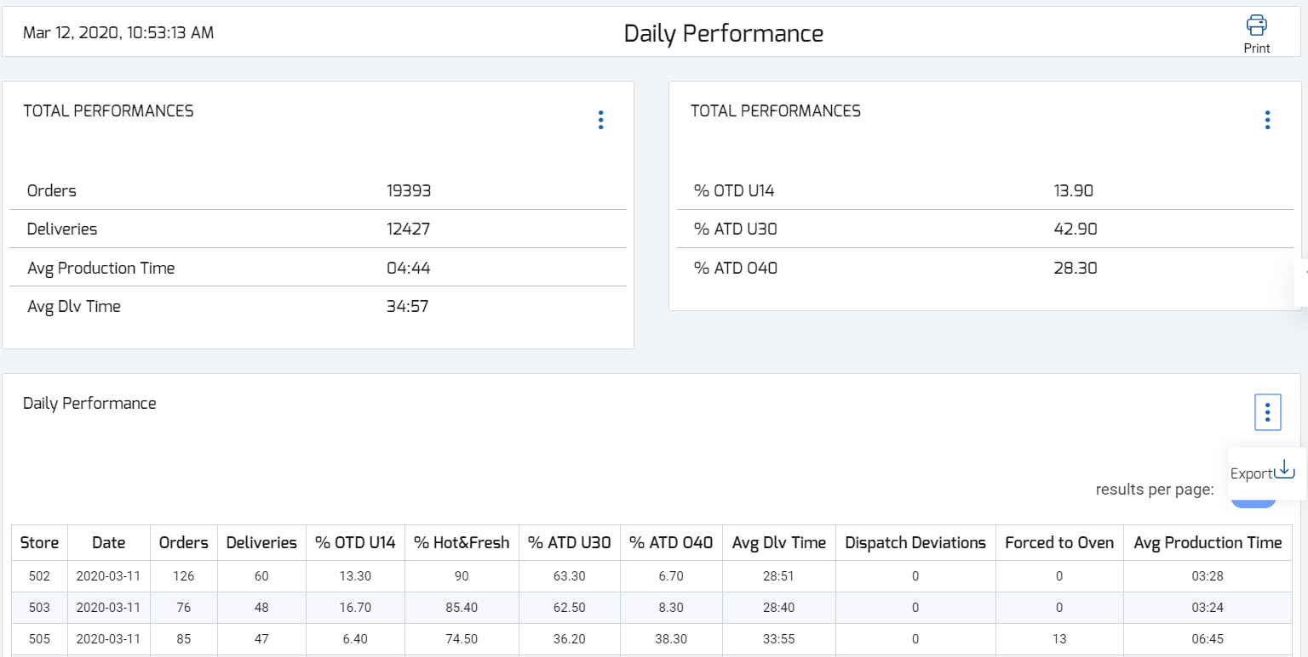
Exporting Reports
There is an option to export reports from the Dashboards to an excel sheet.
This appears as 3 dots by each report/data. Click on the 3 dots icon and then click ‘Export’.
Store/s

Slide 46
Metrics Calculation
ATD
Calculated from the time
the order was taken until it was
delivered to the customer
OTD U14
Calculated from the time the
order was taken until the
order was dispatched
Hot & Fresh U20
Calculated from the order’s pack time until it’s delivery time, if the time was under 20 min the order arrived hot & fresh
Production U3
Calculated from the time the order appeared on the KDS until the order was bumped
(Doesn’t include orders on hold)

Slide 47
“Aggregator” tab

Slide 48
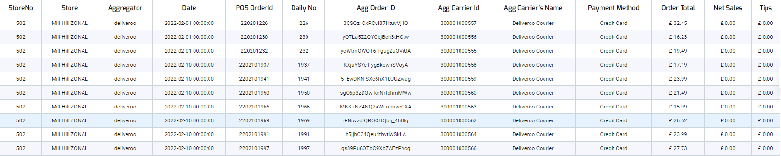
Transaction In Depth
Transaction in depth includes:
Aggregator's activity data for each transaction
Averages pointing drivers performance
Payment breakdown

Slide 49
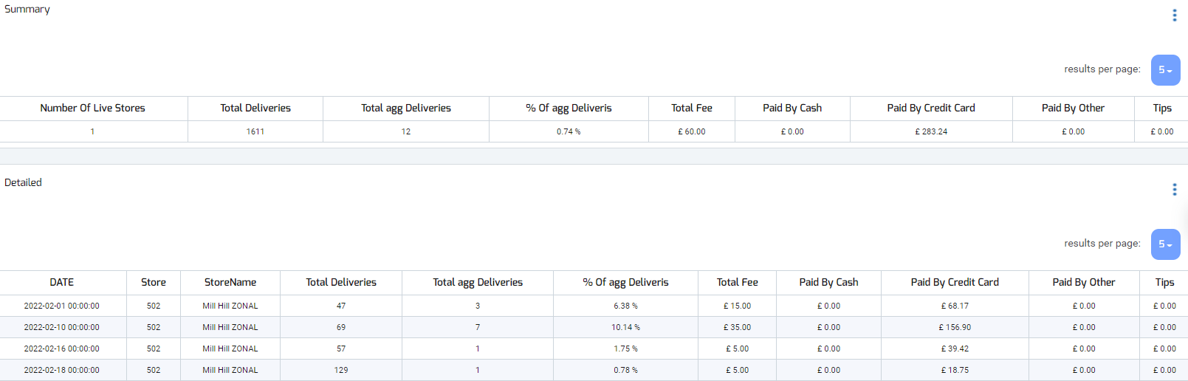
Transaction Summary
Transaction summary includes:
Data summary and details for aggregators activity, user can filter the period desired
Payment and total orders breakdown

Slide 50
“Mileage Calculation” tab

Slide 51
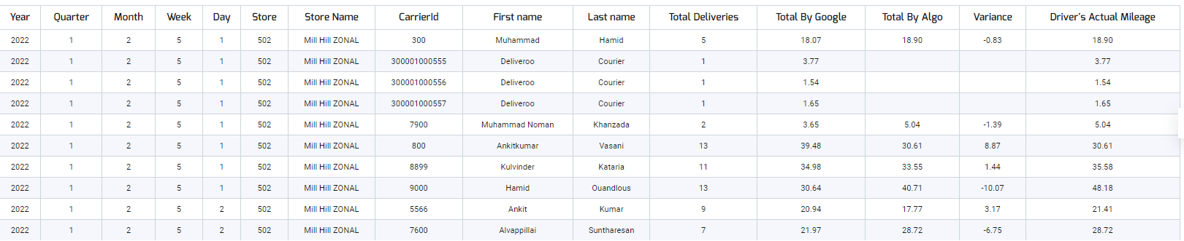
Mileage Breakdown
Mileage breakdown includes:
A breakdown for each driver per day includes distance date and driver details
Total distance drove for the day
Date
Carrier details

Slide 52
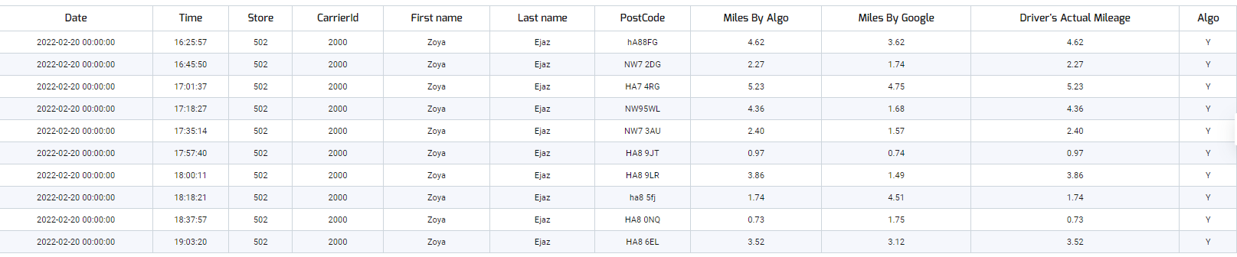
Mileage Per Route
Mileage per route includes:
A breakdown for each delivery includes distance date and driver details
Date and time
Carrier details
Total delivery distance

Slide 53
“Forecast” tab

Slide 54
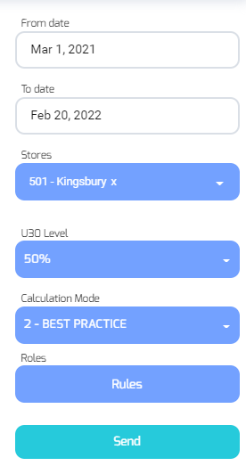
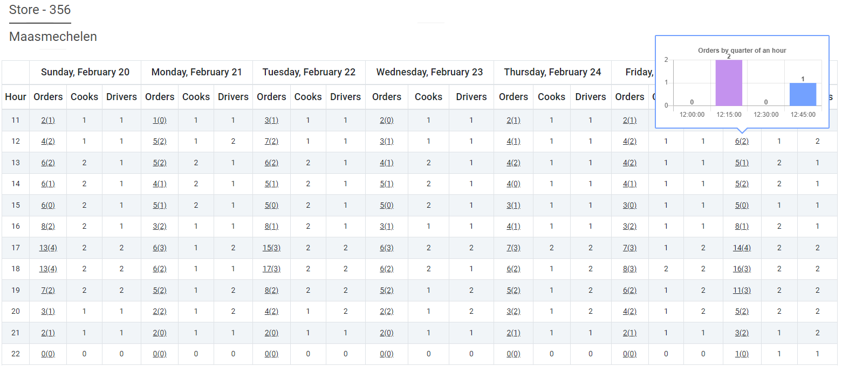
Labor Forecast
Labor forecast includes:
Prediction for the required cooks and drivers according to store desired U30 %
Orders quantity forecast
Cooks required
Drivers required
Select store
Select U30 % level
Select Calculation mode

